Slide 1

Python Course Chapter 15
Emails in Python

Slide 2
Sending Emails with Python
Traditionally, sending emails is chaos, as we need to connect to an email server, confirm the connection, set protocols, log on, and send messages. For example, Simple Mail Transfer Protocol (SMTP) is a protocol that handles sending emails and routing emails between mail servers.
Fortunately, a built-in smtplib library in Python makes the steps simple for us. Python provides smtplib module, which defines an SMTP client session object that can be used to send mail to any Internet machine with an SMTP or ESMTP (Extended SMTP) listener daemon.

Slide 3
Sending Emails with Python
Each major email provider has its own SMTP server. For example, the domain name of google Gmail SMTP server is:
smtp.gmail.com
And Microsoft Outlook server domain name is:
smtp.live.com
For other mail servers, search on the internet.
We will be using Gmail; as of today, Gmail is the most used service worldwide. In fact, in the second quarter of 2020, there are almost 1 billion and 700 thousand active users.

Slide 4
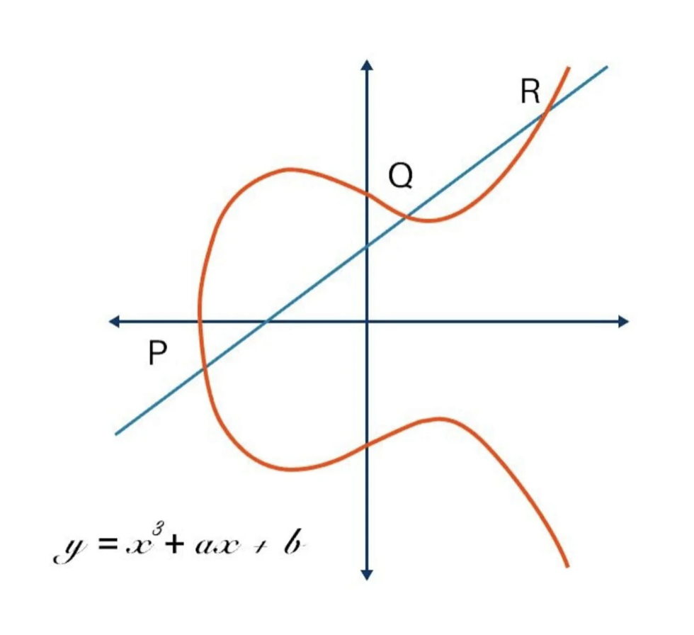
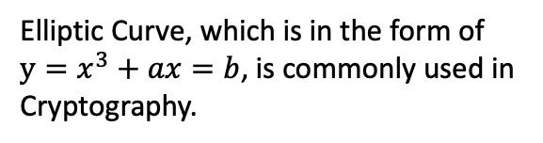
Sending Emails
First, we need to create an smtp object with port number 587; this is the default mail submission port. Modern email servers use port 587 to secure email submission for delivery. Emails are encrypted with RSA, Elliptic Curve Cryptography, and Diffie-Hellman Key Exchange Algorithm.
First of all, we need to import smtp:
import smtp
*. Smtp is in Python standard library; therefore, we don’t need to use pip to download it.
Elliptic Curve, which is in the form of $y=x^{3}+ax=b$, is commonly used in Cryptography.

Slide 5
Sending Emails
This method returns an SMTP instance encapsulates an SMTP connection. It has methods that support a full repertoire of SMTP and ESMTP operations.
Then, we do:
import smtplib smtp_obj = smtplib.SMTP("smtp.gmail.com", 587)
Then, some of the SMTP instance methods we can use include:
ehlo() - Identify yourself to an ESMTP server.
starttls() - Put the SMTP connection in TLS (Transport Layer Security) mode. All SMTP commands that follow will be encrypted.
login(username, password) - Log in on an SMTP server that requires authentication.

Slide 6
Sending Emails
When using 2-Step Verification, some less secure apps or devices may be blocked from accessing your Google Account. Apparently, Python codes do not support 2-Step Verification. Google provides something called App Passwords to create another password to let the blocked App or device access our Google Account.
That means, we can go to:
https://support.google.com/accounts/answer/185833?hl=en/
And then follow the instruction to set up an App Password.

Slide 7

Sending Emails
Some key notes before we continue:
If you have not set up 2-Step Verification for your Google account, this is a good time to do it.
Store the App Password somewhere secure.
After this lecture, delete it.

Slide 8
Sending Emails
Now, we can use smtp_obj.sendmail(from_address, to_address, msg) to send emails. The 3 inputs are:
Sender email address
Receiver email address
The message we will send
Something important to know is - most of the Email server identifies the mail sender. Therefore, no matter what we put as the sender’s email address, it will not change who you are!! The sender shows on the receiver side will be the email address that connects to the email server.
Therefore, do not take the risk if spoofing! Be wise!! Don’t go to jail!!!

Slide 9
Receiving Emails
Python's client-side library called imaplib is used for accessing emails over imap protocol. IMAP stands for Internet Mail Access Protocol. It was first proposed in 1986. The key points of imap are - IMAP allows the client program to manipulate the e-mail message on the server without downloading them on the local computer.
First, we need to do:
Import imaplib
Then, we do:
M = imaplib.IMAP4_SSL("imap.gmail.com")

Slide 10
Receiving Emails
IMAP4_SSL("imap.gmail.com") - creates and returns an instance of IMAP4_SSL by establishing a connection with the host over specified port. It uses the SSL connection which is secure.
SSL means Secure Sockets Layer, and SSL uses symmetric cryptography. The most widely used symmetric algorithms to implement SSL are AES-128, AES-192 and AES-256. Compared to SSL, HTTPs uses the RSA algorithm, which is asymmetric cryptography.
Then, some of the IMAP4_SSL instance methods we can use include:

Slide 11
Receiving Emails
M.login(email, password) – Log in on an email server that requires authentication.
M.list() – returns a tuple which include the information of different folders of the account, such as inbox, trash can, drafts.
M.select(str) – select the str folder to work on.
M.search(None, criterion) – search emails based on the criterion, and returns a tuple which include information of the email ids that meet the criterion.
M.fetch(id, "(RFC822)") – fetch the content of the email based on id. RFC822 means we are taking electronic message consisting of header fields and message body.

